Slide 1
Chapter 30 Induction and Inductance
In this chapter we will study the following topics:
-Faraday’s law of induction -Lenz’s rule -Electric field induced by a changing magnetic field -Inductance and mutual inductance - RL circuits -Energy stored in a magnetic field
(30 – 1)

Slide 2
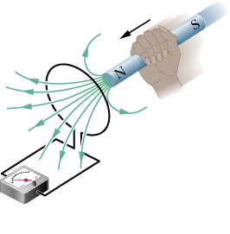
(30 – 2)

Slide 3
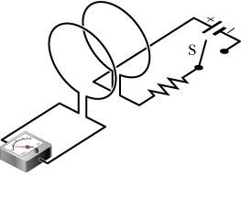
(30 – 3)
loop 1
loop 2

Slide 4
(30 – 4)

Slide 5
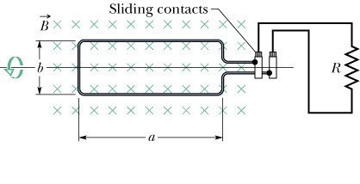
loop
(30 – 5)

Slide 6
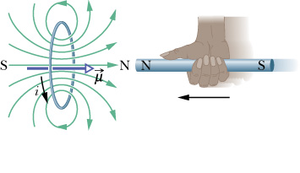
(30 – 6)

Slide 7
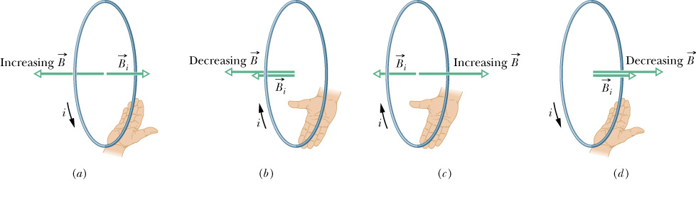
N
S
magnet motion
(30 – 7)

Slide 8
N
S
magnet motion
(30 – 8)

Slide 9
S
N
magnet motion
(30 – 9)

Slide 10
S
N
magnet motion
(30 –10)

Slide 11
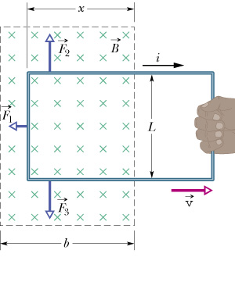
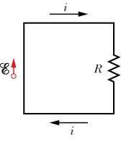
(30 –11)

Slide 12
(30 –12)

Slide 13
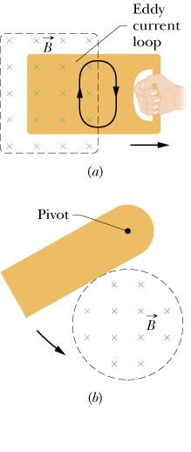
(30 –13)

Slide 14
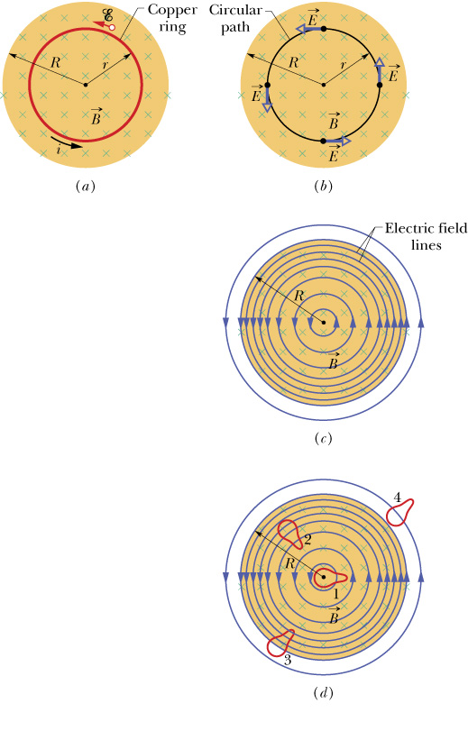
(30 –14)

Slide 15
(30 –15)

Slide 16
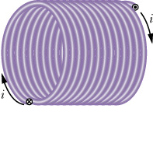
(30 –16)

Slide 17
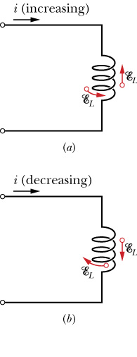
loop 1
loop 2
(30 –17)

Slide 18
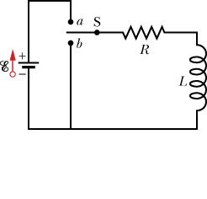
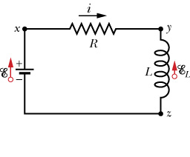

Slide 19
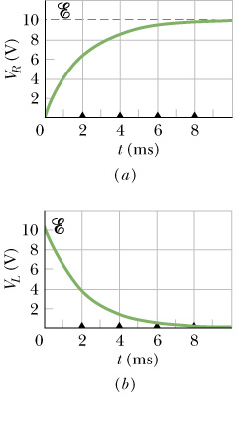
(30 –19)

Slide 20
(30 –20)

Slide 21
(30 –21)

Slide 22
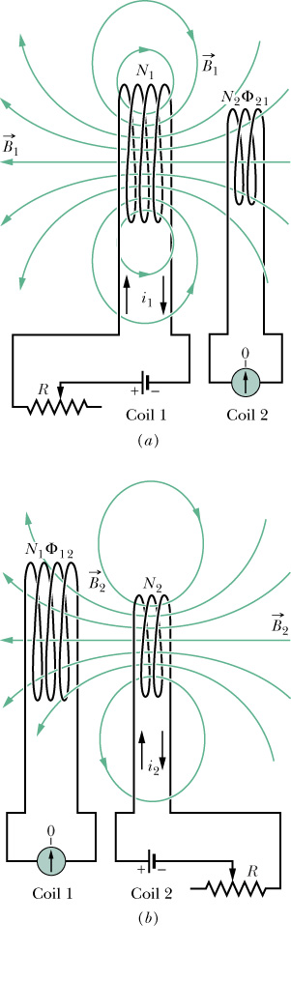
N₁
N₂
(30 –22)

Slide 23
N₁
(30 –23)
N₂

Slide 24
N₁
(30 –24)
N₂

